Slide 1
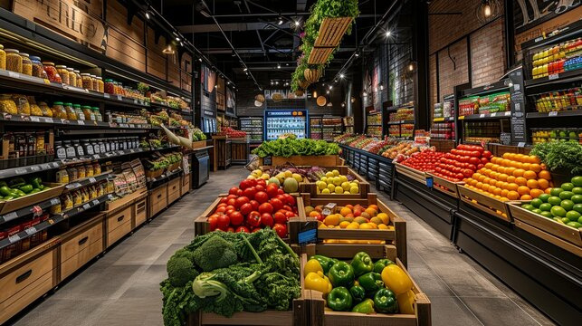
SUPER-STORE POS SYSTEM

Slide 2


SUPERSTORE POS SYSTEM
IMR Project
INTRO

Slide 3


SUPERSTORE POS SYSTEM
IMR Project
Version Control

Slide 4

SUPERSTORE POS SYSTEM
IMR Project
Design Inspiration

Slide 5

SUPERSTORE POS SYSTEM
IMR Project
Project Management

Slide 6


SUPERSTORE POS SYSTEM
IMR Project
Teams
DOC Team
Reporting & Documentation
DESIGN Team
Diagraming & Designing
SQL Team
Application Building & Coding

Slide 7
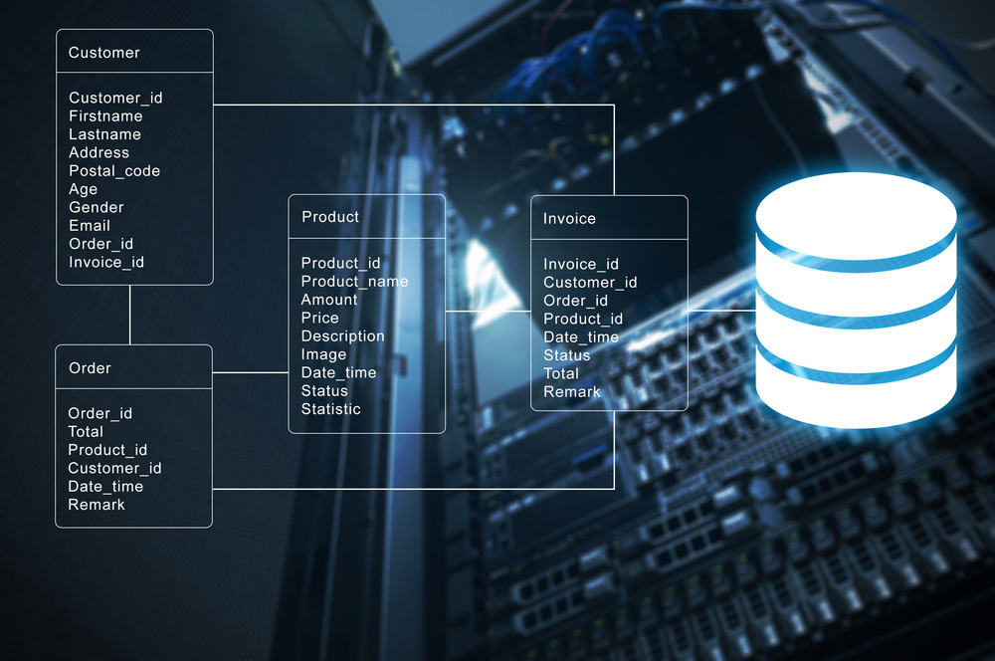
SUPERSTORE POS SYSTEM
IMR Project
Database Tables, Sample Data
Data Validation & Database Diagram
TEAM SQL

Slide 8

SUPERSTORE POS SYSTEM
IMR Project
My Details...
Name -
IRUGALBANDARA I B Y D
Student ID -
10952358
Student Email -
10952358@students.plymouth.ac.uk
On Github -
DilshanIBY
In Contact -
(+94) 71 010 3793

Slide 9
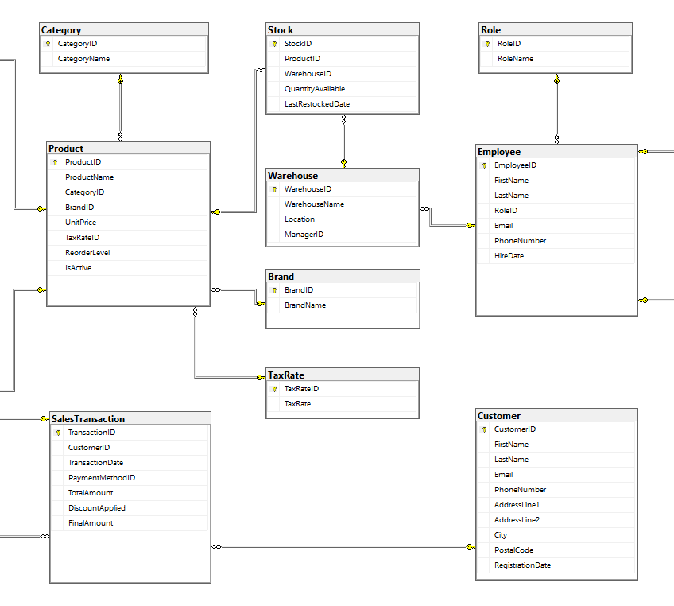
SUPERSTORE POS SYSTEM
IMR Project
WHAT I Created...?
Database Tables & Sample Data
Database Diagram
Data Validation & Constraints
APP - In App Data Validation
APP - Tables Joints

Slide 10
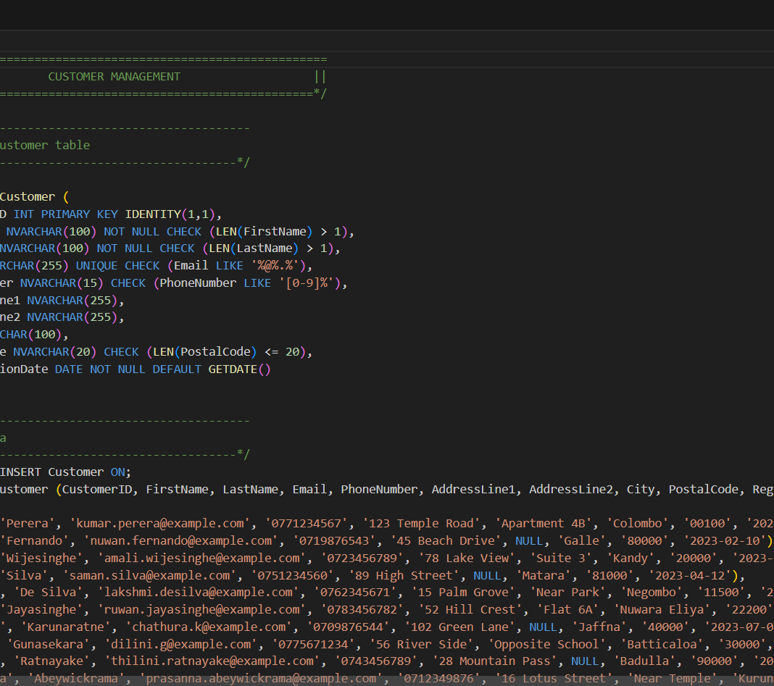
SUPERSTORE POS SYSTEM
IMR Project
HOW They Work...?
Database Tables & Sample Data
Database Diagram
Data Validation & Constraints
APP - In App Data Validation
APP - Tables Joints

Slide 11

SUPERSTORE POS SYSTEM
IMR Project
ER/EER Diagram
TEAM DESIGN

Slide 12
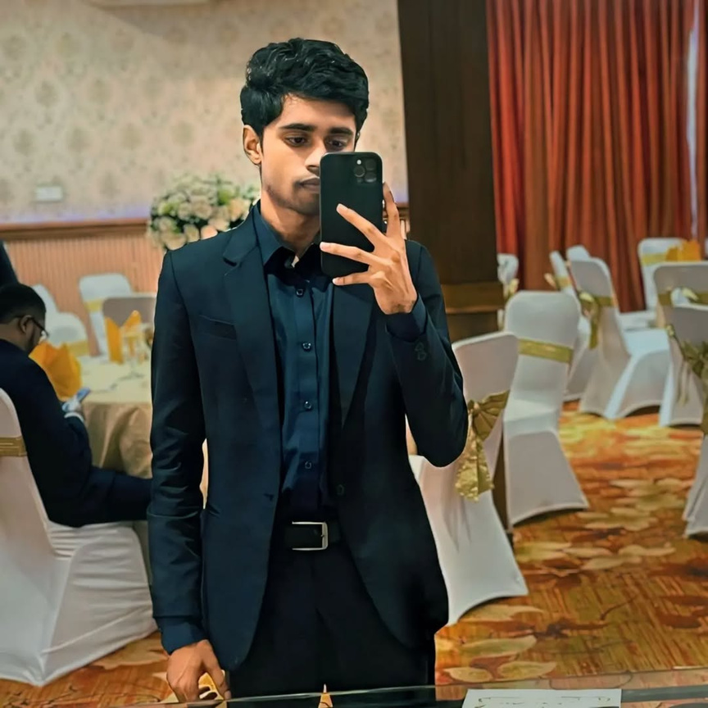
SUPERSTORE POS SYSTEM
IMR Project
My Details...
Name -
G.Kishalan
Student ID -
10953233
Student Email -
10953233@students.plymouth.ac.uk
On Github -
gkishalan
In Contact -
(+94) 77 0478896

Slide 13
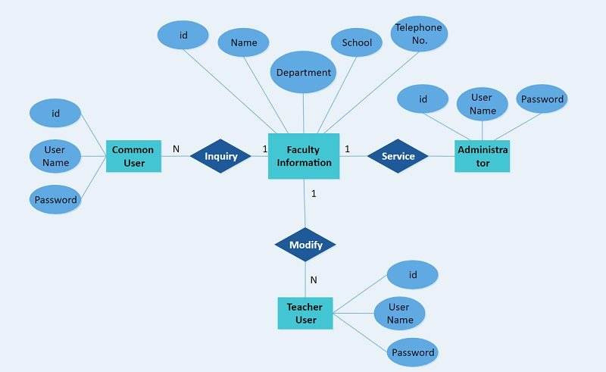
SUPERSTORE POS SYSTEM
IMR Project
WHY I Created...?
Entities
Attributes
Relationships
Multivalued attributes

Slide 14

SUPERSTORE POS SYSTEM
IMR Project
HOW I Created...?
Entities
Attributes
Relationships
Multivalued attributes

Slide 15

SUPERSTORE POS SYSTEM
IMR Project
Normalization & Finalizing repot works
TEAM Desing

Slide 16

SUPERSTORE POS SYSTEM
IMR Project
My Details...
Name -
R.M.M.M.P.Rajakaruna
Student ID -
10953336
Student Email -
10953336@students.plymouth.ac.uk
On Github -
MPrajakaruna
In Contact -
(+94) 70 3486779

Slide 17
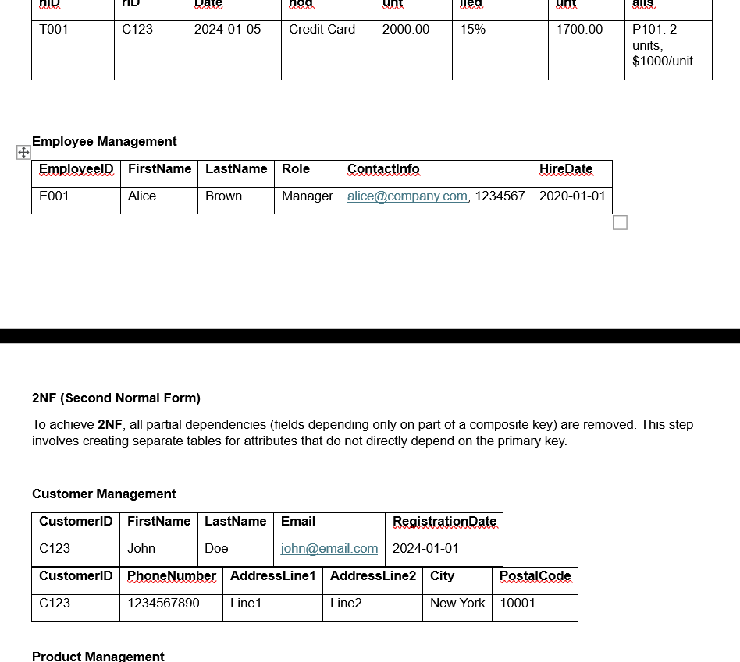
SUPERSTORE POS SYSTEM
IMR Project
WHAT I Created...?
Normalization
Finalize Report

Slide 18
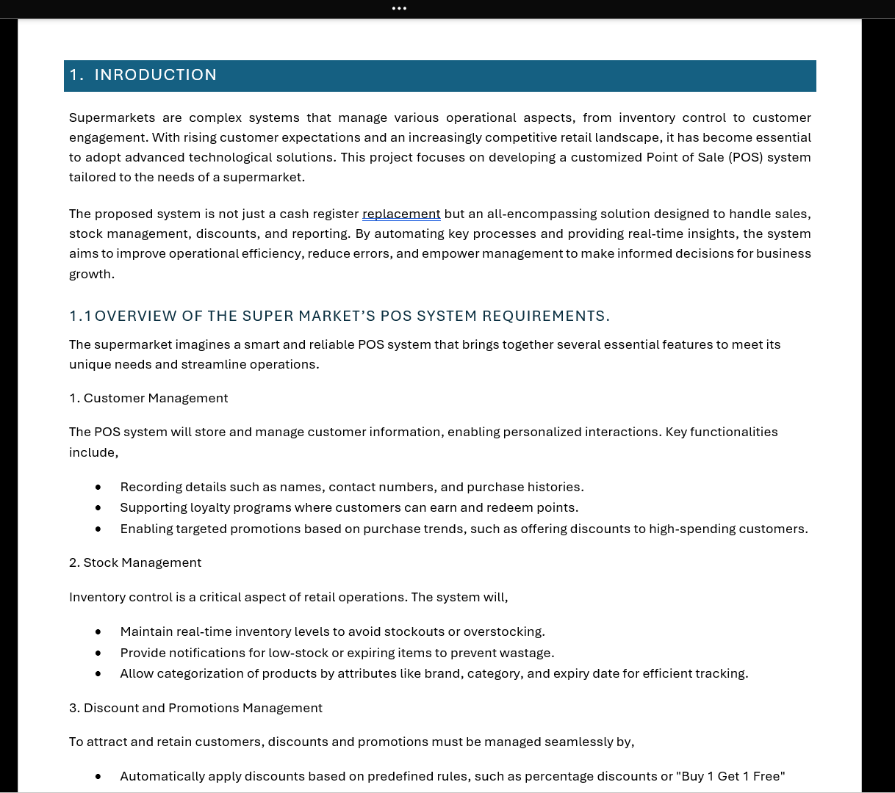
SUPERSTORE POS SYSTEM
IMR Project
HOW I Created...?
Normalization
Report

Slide 19

IMR Project
SUPERSTORE POS SYSTEM
Relational Mapping
TEAM DESIGN

Slide 20

SUPERSTORE POS SYSTEM
IMR Project
My Details...
Name -
G.Sathushan
Student ID -
10953377
Student Email -
10953377@students.plymouth.ac.uk
On Github -
sathushan64
In Contact -
(+94) 76 186 4177

Slide 21

SUPERSTORE POS SYSTEM
IMR Project
WHY I Created...?
Relationship Mapping

Slide 22


SUPERSTORE POS SYSTEM
IMR Project
HOW I Created...?
Relationship Mapping

Slide 23
SUPERSTORE POS SYSTEM
IMR Project
Data Dictionary & Finalize the Database Backup
TEAM Desing

Slide 24

SUPERSTORE POS SYSTEM
IMR Project
My Details...
Name -
R.M.M.M.P.Rajakaruna
Student ID -
10953336
Student Email -
10953336@students.plymouth.ac.uk
On Github -
MPrajakaruna
In Contact -
(+94) 70 3486779

Slide 25
SUPERSTORE POS SYSTEM
IMR Project
WHY I Created...?
Data Dictionary
Finalize the Database Backup

Slide 26
SUPERSTORE POS SYSTEM
IMR Project
HOW I Created...?
Data Dictionary
Finalize the Database Backup

Slide 27


SUPERSTORE POS SYSTEM
IMR Project
Data Security & Complete Database Code
TEAM DOC

Slide 28
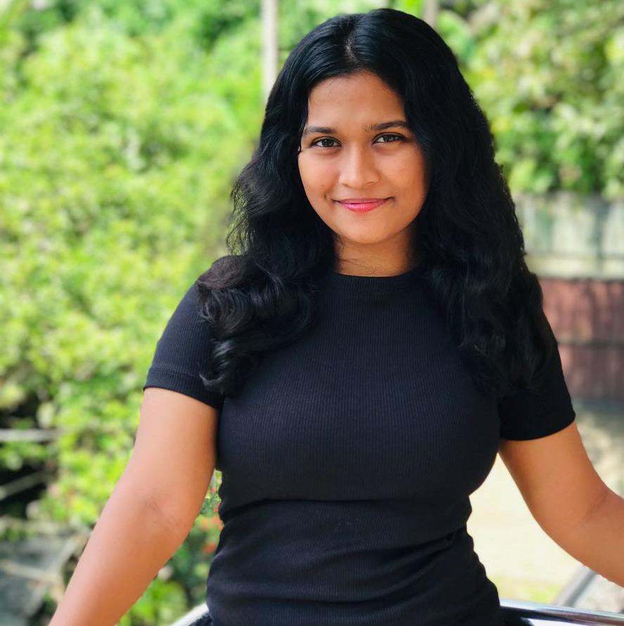
SUPERSTORE POS SYSTEM
IMR Project
My Details...
Name -
H G L D K Hathnapitiya
Student ID -
10953524
Student Email -
10953524@students.plymouth.ac.uk
On Github -
Lakii110
In Contact -
(+94) 779913655

Slide 29
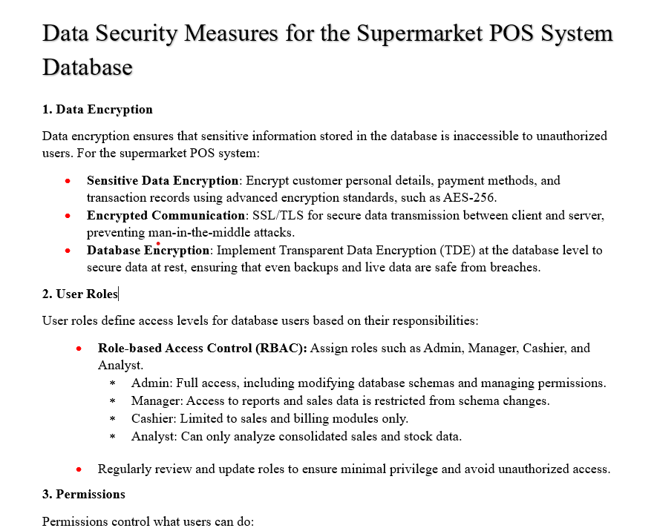
SUPERSTORE POS SYSTEM
IMR Project
WHAT I Created...?
Data Security
Risk Analysis
Complete database code

Slide 30
SUPERSTORE POS SYSTEM
IMR Project
HOW I Created...?
Data Security
Risk Analysis
Complete database code

Slide 31
SUPERSTORE POS SYSTEM
IMR Project
critical analysis, reference &table of content
TEAM DOC

Slide 32

SUPERSTORE POS SYSTEM
IMR Project
My Details...
Name -
H.H.D.J.V.Herath
Student ID -
10953572
Student Email -
10953572@students.plymouth.ac.uk
On Github -
jeesa2003
In Contact -
(+94) 741917002

Slide 33
SUPERSTORE POS SYSTEM
IMR Project
WHY I Created...?
Analysis of weakness
Analysis of strength
Future Implementation

Slide 34
SUPERSTORE POS SYSTEM
IMR Project
HOW I Created...?
Analysis of weakness
Analysis of strength
Future Implementation

Slide 35
SUPERSTORE POS SYSTEM
IMR Project
Introduction,
workload matrix,
cover page
TEAM DOC

Slide 36

SUPERSTORE POS SYSTEM
IMR Project
My Details...
Name -
Senadheera M.V.I
Student ID -
10953249
Student Email -
10953249@students.plymouth.ac.uk
On Github -
Methya2003
In Contact -
(+94) 70 141 1634

Slide 37
SUPERSTORE POS SYSTEM
IMR Project
How I Created...?
Researched the project
Designed the workload matrix in a structured format
Cover page incorporating the project title

Slide 38
SUPERSTORE POS SYSTEM
IMR Project
Functions And Views
TEAM SQL

Slide 39

SUPERSTORE POS SYSTEM
IMR Project
My Details...
Name -
Rajapaksha R P W D G
Student ID -
10953476
Student Email -
10953476@students.plymouth.ac.uk
On Github -
Denuwan10
In Contact -
(+94) 76 994 0877

Slide 40
SUPERSTORE POS SYSTEM
IMR Project
WHAT I Created...?
Functions
Views

Slide 41
SUPERSTORE POS SYSTEM
IMR Project
HOW They Work...?
Functions
Views

Slide 42
SUPERSTORE POS SYSTEM
IMR Project
Procedures, Triggers & C# Application
TEAM SQL

Slide 43

SUPERSTORE POS SYSTEM
IMR Project
My Details...
Name -
R J Ganegame
Student ID -
10953783
Student Email -
10953783@students.plymouth.ac.uk
On Github -
Ranuka-Jayesh
In Contact -
(+94) 75 930 7059

Slide 44
SUPERSTORE POS SYSTEM
IMR Project
WHAT I Created...?
Procedures
Triggers
C# Application

Slide 45
SUPERSTORE POS SYSTEM
IMR Project
HOW They Work...?
Procedures
Triggers

Slide 46

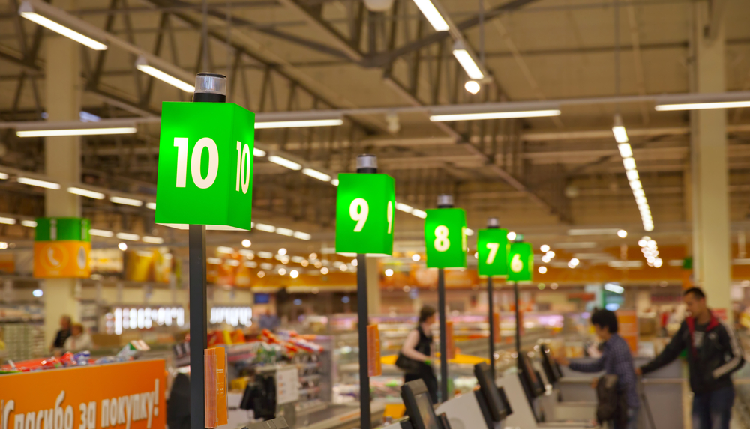
PROJECT
SUPER-STORE POS
Thank you!

